Slide 1
Keys in Relational Model
Presented By
Afjal H. Sarower
afjal.cse@diu.edu.bd

Slide 2
এই Lesson এ কি শিখব?
What is Key?
Super Key
Candidate Key
Composite Key
Primary Key and
Foreign Key

Slide 3

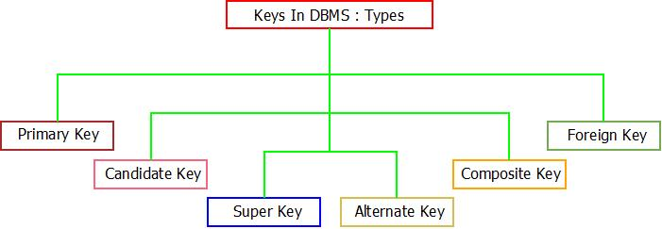
Key in DBMS
A DBMS key is an attribute or set of an attribute which helps you to identify a row (tuple) in a relation (table).
Keys help you uniquely identify a row in a table by a combination of one or more columns in that table.

Slide 4
Necessity of Key
Keys help you to identify any row of data in a table. In a real-world application, a table could contain thousands of records. Moreover, the records could be duplicated. Keys in RDBMS ensure that you can uniquely identify a table record despite these challenges.
Allows you to establish a relationship between and identify the relation between tables
Help you to enforce identity and integrity in the relationship.

Slide 5
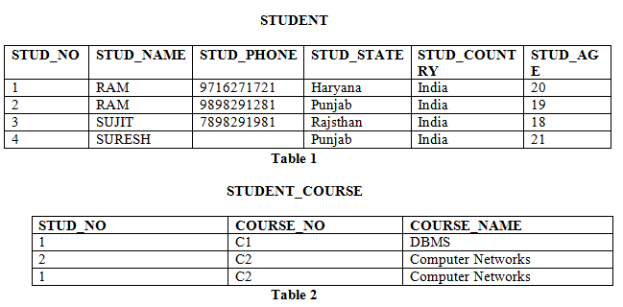
Super Key
The set of attributes which can uniquely identify a tuple is known as Super Key.
For Example, STUD_NO, (STUD_NO, STUD_NAME), PhoneNo, (Phone no, state)

Slide 6
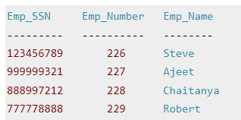
The above table has following super keys. All of the following sets of super key are able to uniquely identify a row of the employee table.
{Emp_SSN}
{Emp_Number}
{Emp_SSN, Emp_Number}
{Emp_SSN, Emp_Name}
{Emp_SSN, Emp_Number, Emp_Name}
{Emp_Number, Emp_Name}

Slide 7
Candidate Key
The minimal set of attribute which can uniquely identify a tuple is known as candidate key.
For Example, STUD_NO in STUDENT relation.
The candidate key can be simple (having only one attribute) or composite as well.
For Example, {STUD_NO, COURSE_NO} is a composite candidate key for relation STUDENT_COURSE.

Slide 8
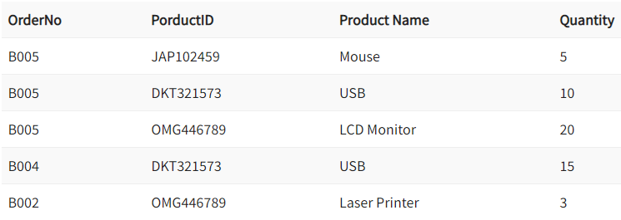
Composite Key
COMPOSITE KEY is a combination of two or more columns that uniquely identify rows in a table. The combination of columns guarantees uniqueness, though individually uniqueness is not guaranteed.

Slide 9
Primary Key
There can be more than one candidate key in relation out of which one can be chosen as the primary key.
For Example, STUD_NO, as well as STUD_PHONE both, are candidate keys for relation STUDENT but STUD_NO can be chosen as the primary key (only one out of many candidate keys).

Slide 10
Rules for Primary Key
Two rows can’t have the same primary key value
The primary key field cannot be null.
The value in a primary key column can never be modified or updated if any foreign key refers to that primary key.

Slide 11
Foreign Key
For Example, STUD_NO in STUDENT_COURSE is a foreign key to STUD_NO in STUDENT relation.

Slide 12
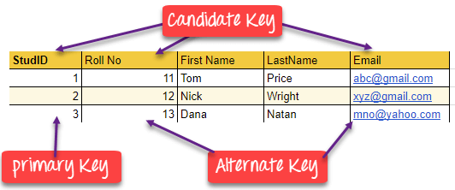
Alternate Key
The candidate key other than the primary key is called an alternate key.

Slide 13
“Opportunities don’t happen, you create them.”
– – Chris Grosser

